Slide 1

Database Management Systems

Slide 2
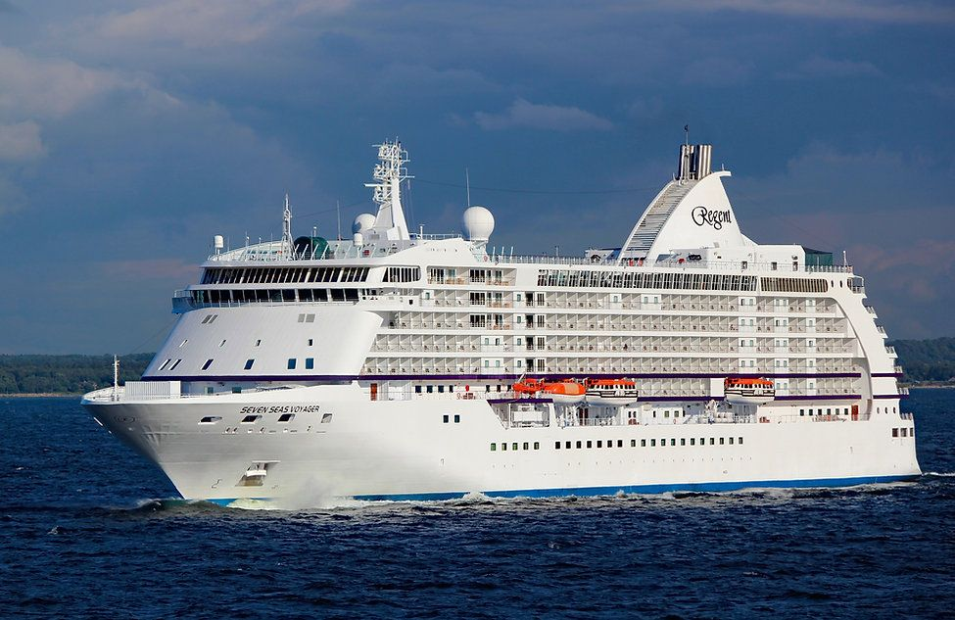

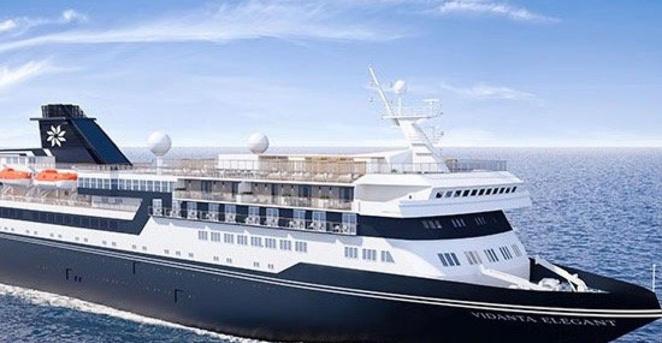
Database Management Systems Cruise Ship Management
By
V.YESHWANTH(2110030216)
A.VARSHITH(2110030128)
M.SONU NISHANTH YADAV(2110030112)
NARSIPURA ABHINAV(2110030159)
Under the guidance of
( Mr.Sumit Hazra )

Slide 3
Problem statement and domain
We have come here with an “CRUISE SHIP MANAGEMENT”.
Passengers should go to the stall to get anything he want.
Controlling the crowd near the stalls will be very difficult to the management.
Waiting for movie tickets party halls beauty salons may lead to consume more time

Slide 4

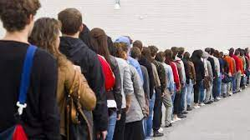


Consumes lots of time
Should stand in a queue for longer time
Consumes lots of man’s energy
Instead we can use online booking for getting access to any of the aminities in the cruise.
This helps in solving the above problems very easily and can be efficient.

Slide 5
Existing solutions / NaTive solutions
Manages all the orders of the passengers in the ship.
This consumes less time for a passenger to get their order from a required stall.
Used to improve the problems existing in the management .
Cruise management system brings a genuine confidence that their technical management team is fully engaged, immensely experienced and exceptionally driven to meet your specific needs

Slide 6
Proposed Algorithm Design Technique
What is the technique
How is it suitable for your application
What do you know about the solution of it using proposed design method

Slide 7
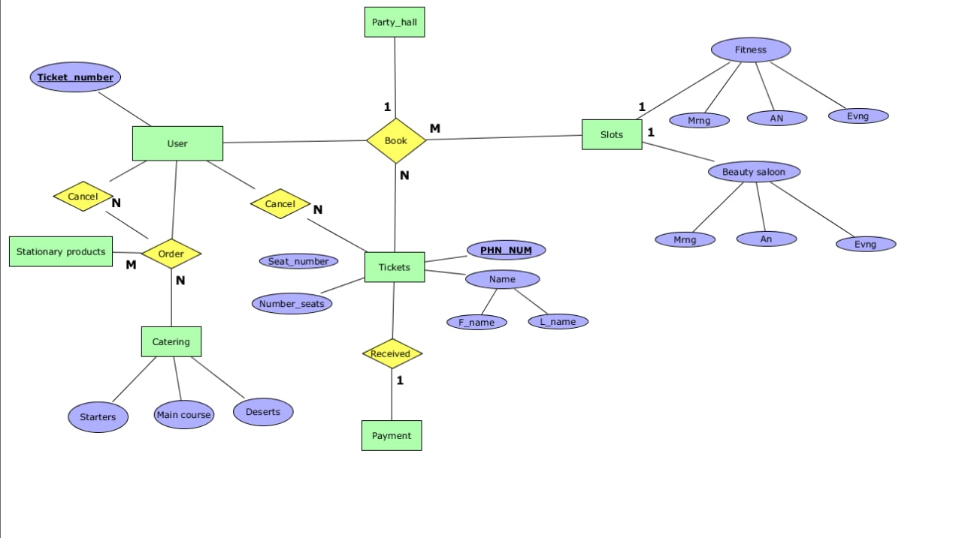
ER DIAGRAM

Slide 8
Data Structures needed
1- Lists
2-Arrays
3- Entity relation

Slide 9
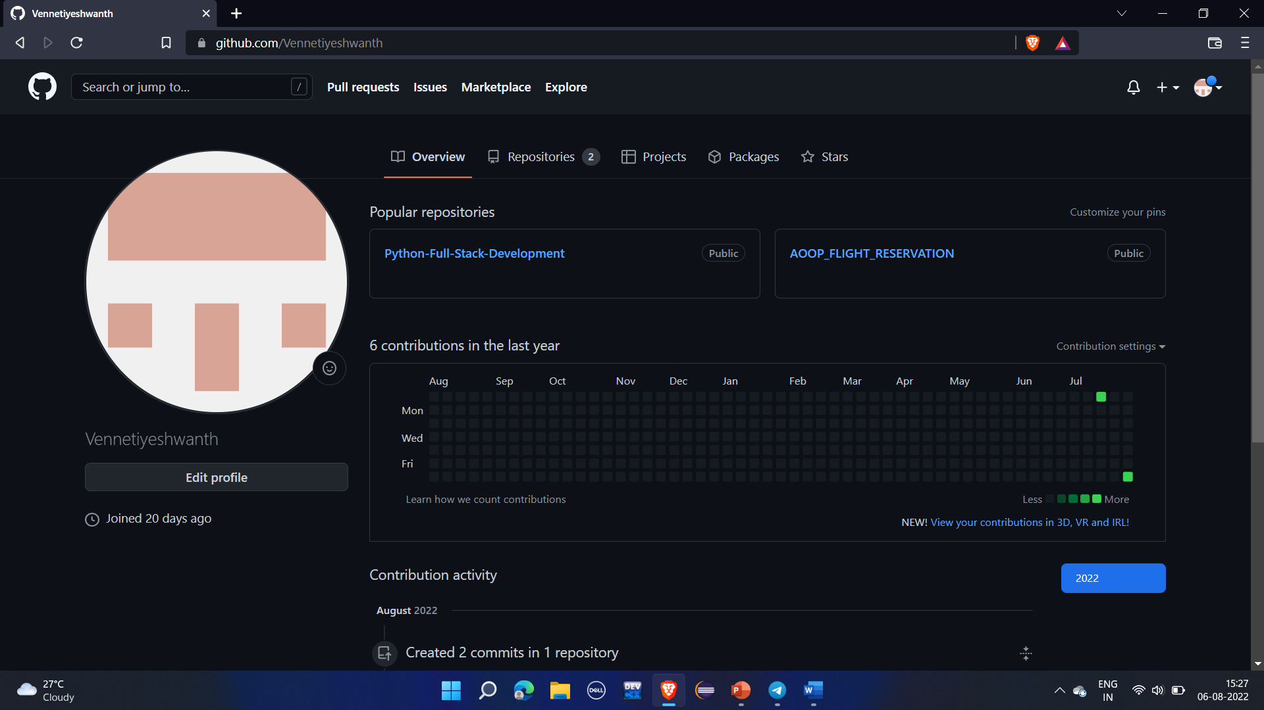
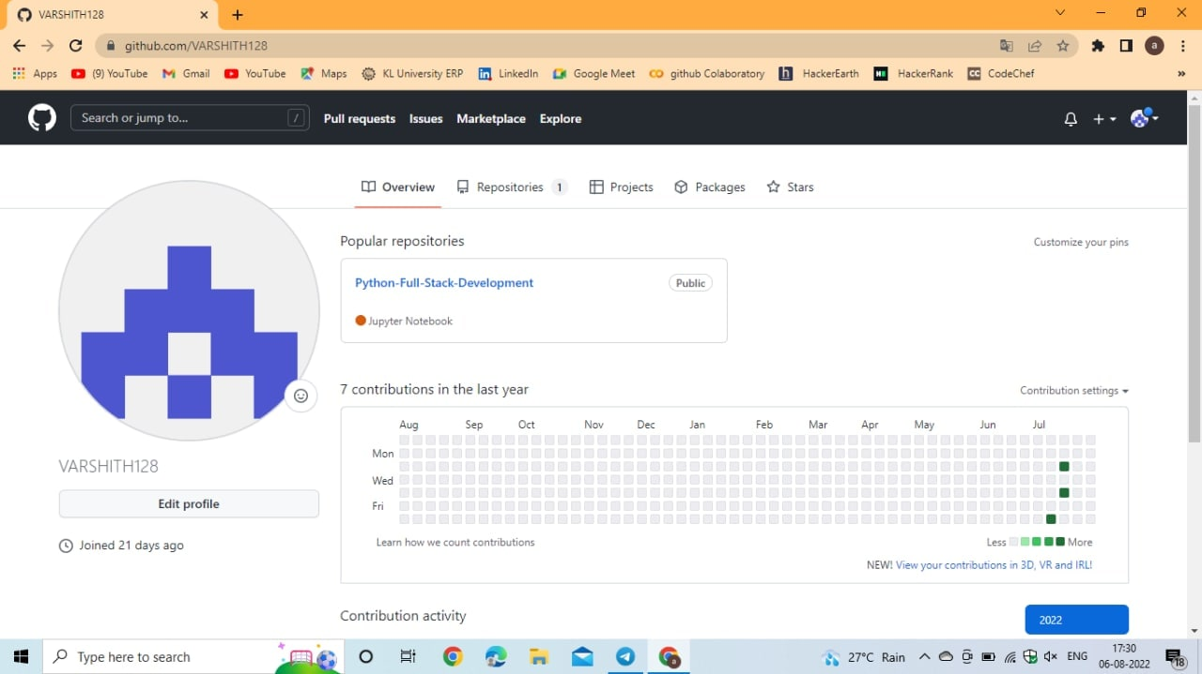
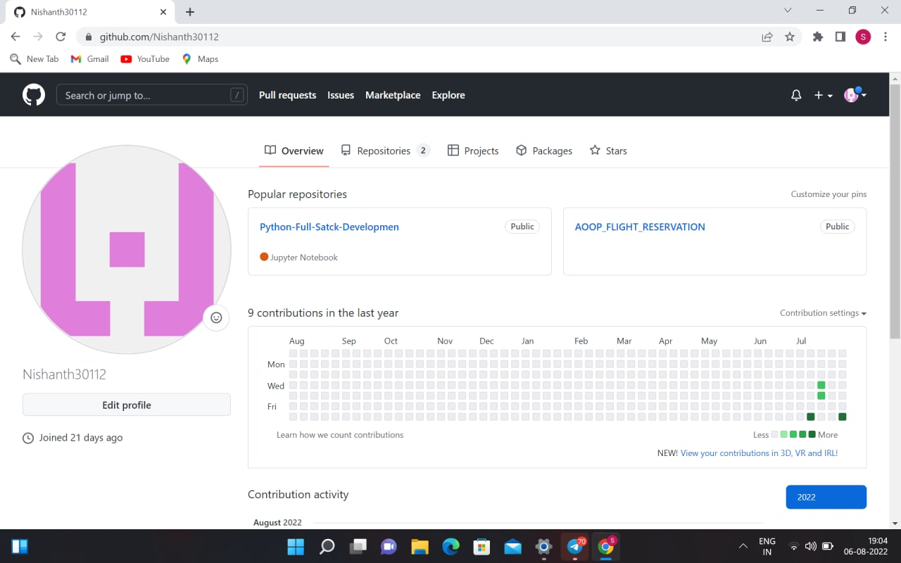
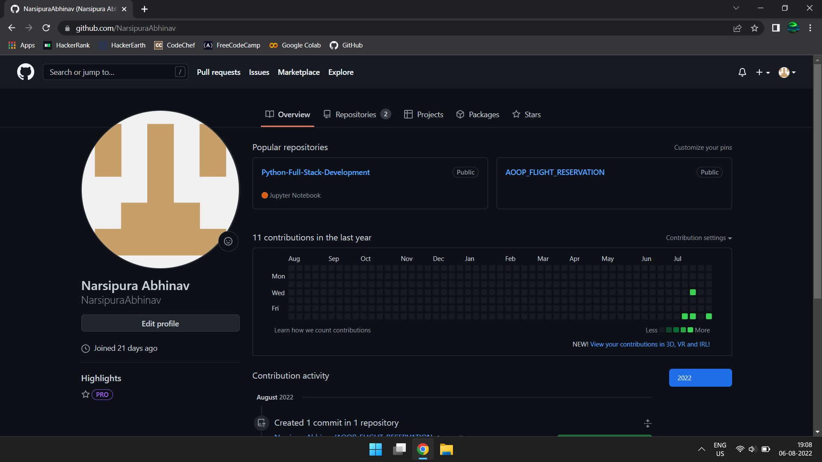
Github setup

Slide 10
Division of work among the group members
YESHWANTH - Code Development
SONU NISHANTH - Code Development
VARSHITH - Class diagram
ABHINAV - Er diagram

